Slide 1
CS213 Recitation 10
Notes:
Hello, everyone. In today’s recitation, let’s go over some knowledge points about

Slide 2
Android Basics
Activity Lifecycle
Notes:
These are the contents we will cover today.

Slide 3
What is Android
A mobile operating system that is based on a modified version of Linux
Another well-known mobile operating system is IOS
Originally developed by a startup of the same name, Android, Inc, which was acquired by Google in 2005
Android is developed by Google until the latest changes and updates are ready to be released, at which point the source code is made available to the Android Open Source Project (AOSP), an open source initiative led by Google
More details about Android: https://www.android.com/
Recall Google Play. It serves as the official app store for certified devices running on the Android operating system and its derivatives as well as ChromeOS, allowing users to browse and download applications developed with the Android software development kit (SDK) and published through Google. It’s an important application and platform in Android ecosystem.

Slide 4
What is Android
Most of the Android code was released under the open-source Apache License
The software distributed under the terms of the Apache License is a non-copyleft form of free and open-source software (FOSS). Open source software refers to software people can modify and share because its design is publicly accessible.
More details about Apache: https://www.apache.org/licenses/LICENSE-2.0
The main advantage to adopting Android is that it offers a unified approach to mobile application development
Android devices: Wear OS, Android TV, Android for Cars, Chrome OS devices, Android phones, Android tablets

Slide 5
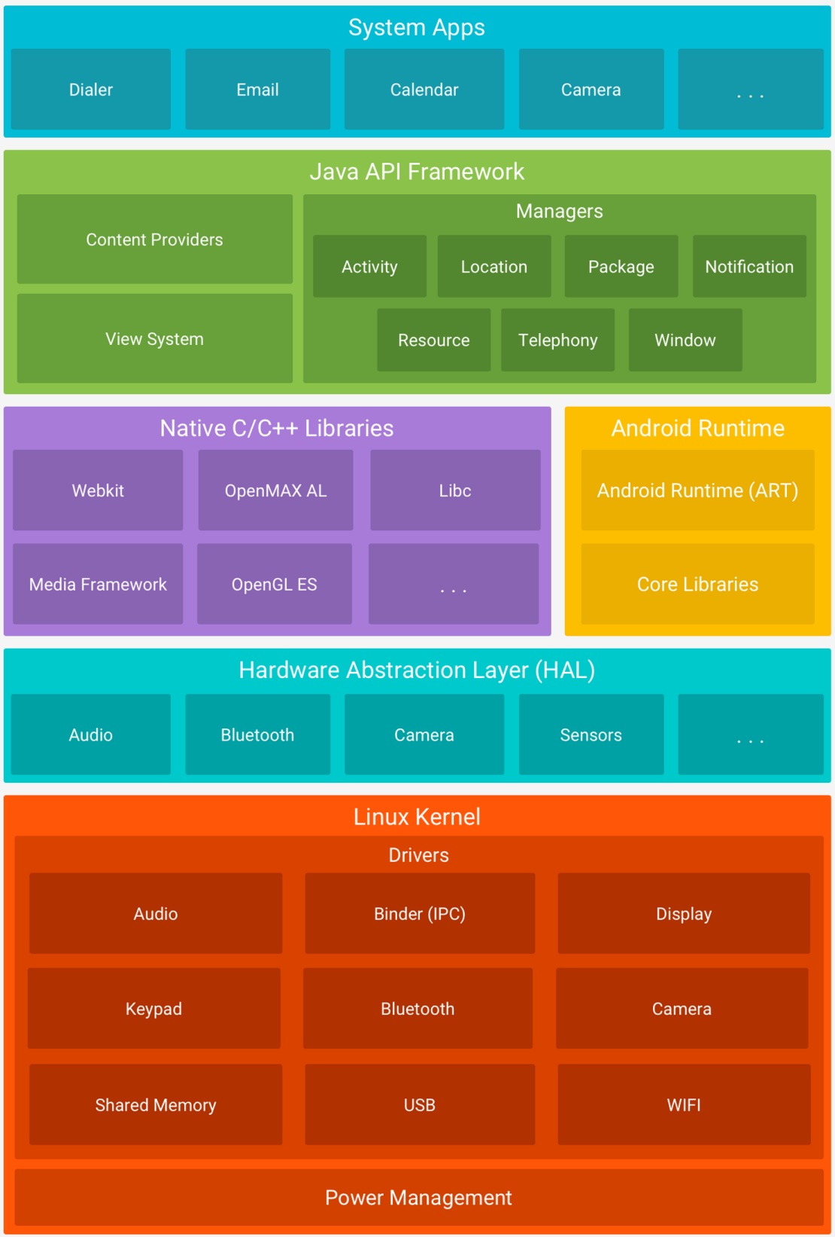
Android Platform Architecture
Android runtime provides a set of core libraries that enable developers to write Android apps using the Java programming language
Java API Framework is layer that Android applications connect directly to.
Below Android Runtime, there are layers: Hardware Abstraction layer and Linux Kernel. Recall that Android operating system is based on Linux.
Notes:
Android Runtime (ART) is an application runtime environment used by the Android operating system. Replacing Dalvik, the process virtual machine originally used by Android, ART performs the translation of the application's bytecode into native instructions that are later executed by the device's runtime environment.

Slide 6
Required Tools
Android Studio as IDE + Android SDK: https://developer.android.com/studio
IntelliJ also includes the Android Studio IDE
Android devices don’t run .class and .jar files. Instead, to improve speed and battery performance, Android devices use their own optimized formats for compiled code.
Resources for Android developers: https://developer.android.com/
Then you can create Android Virtual Devices(AVD) to run your application on emulator.

Slide 7
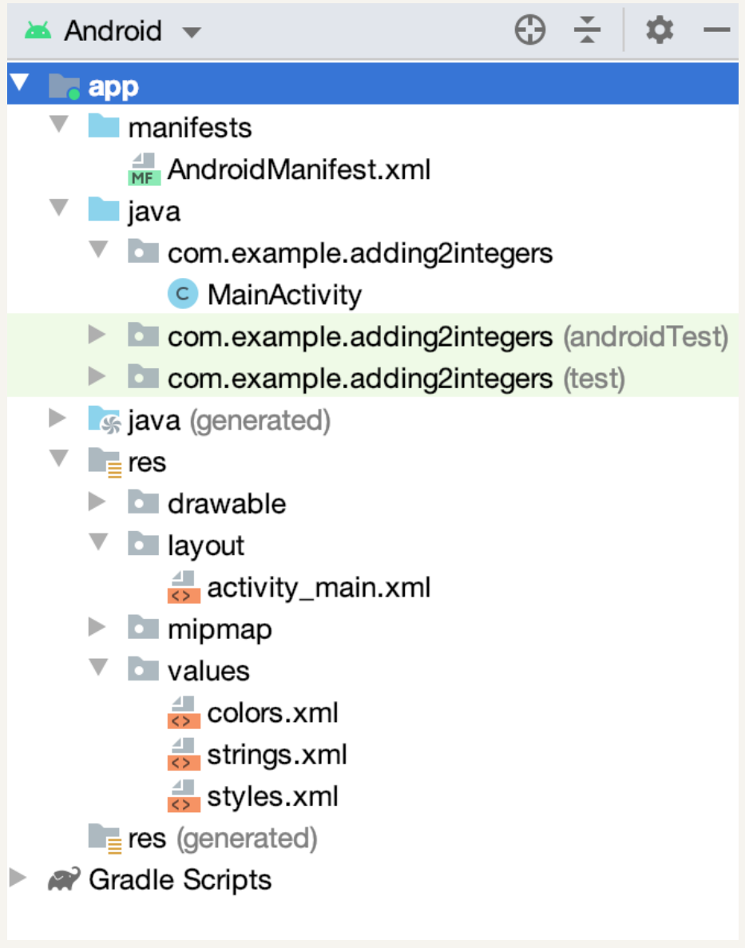
Code architecture
Source folder
MainActivity.java (the controller)
res folder
layout folder, activity_main.xml (the view)
drawable folder, hold images with different resolutions and pixel densities (DPI) values
mipmap, app icons
values, constants
Gradle
the build system

Slide 8
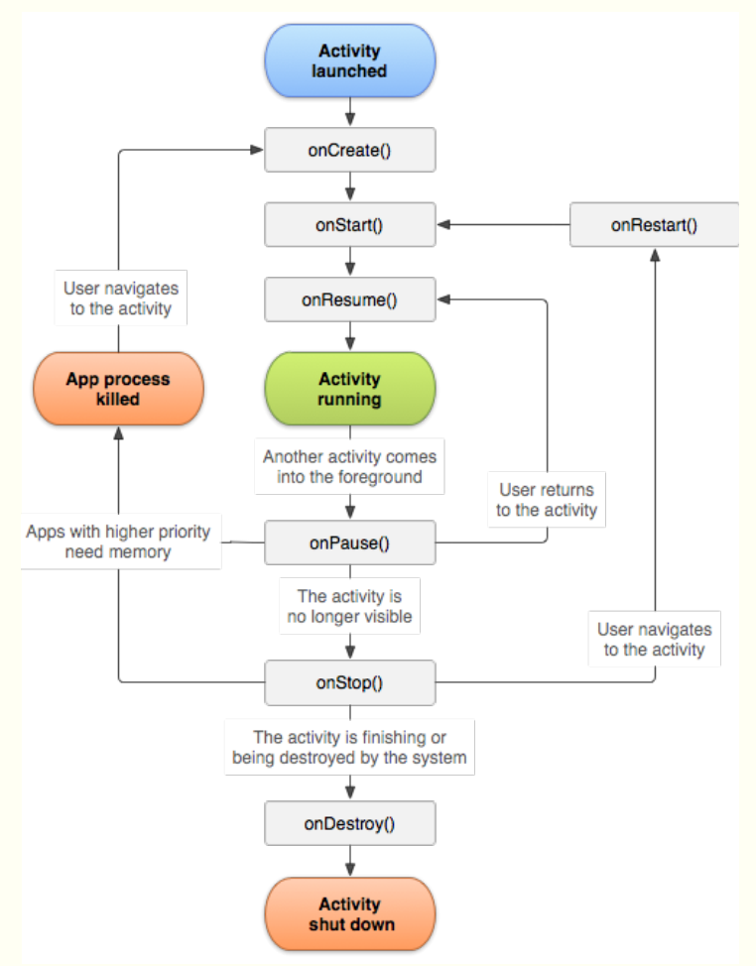
Activity Lifecycle

Slide 9
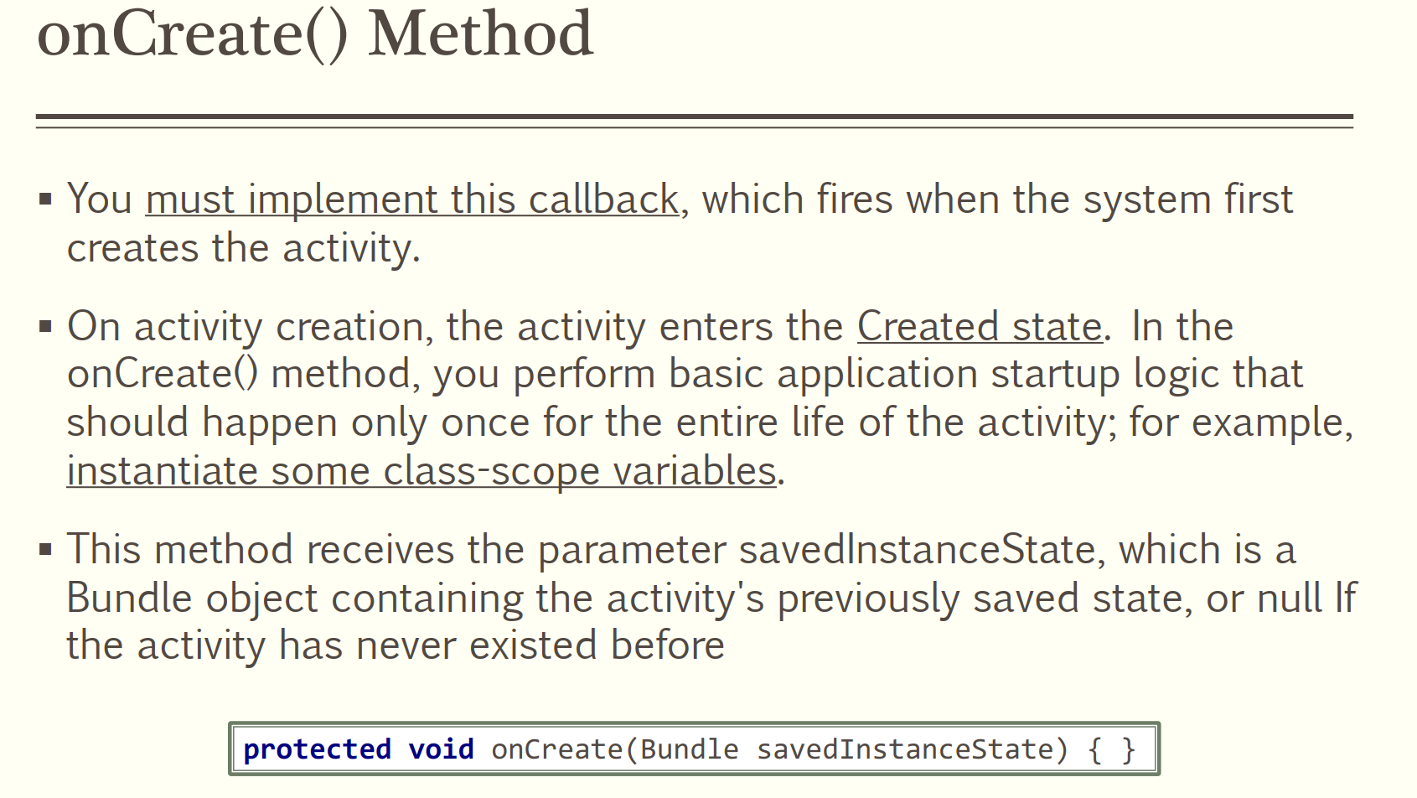

Slide 10
onStart
When the activity enters the Started state, the system invokes this callback. The onStart() call makes the activity visible to the user, as the app prepares for the activity to enter the foreground and become interactive. For example, this method is where the app initializes the code that maintains the UI.
When the activity moves to the started state, any lifecycle-aware component tied to the activity's lifecycle will receive the ON_START event.

Slide 11
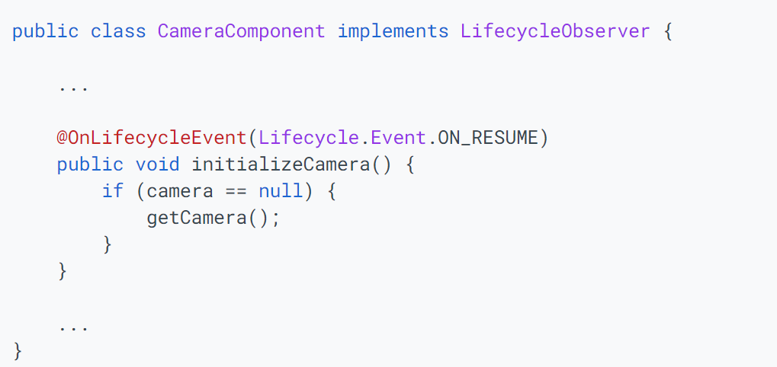
onResume()
When the activity enters the Resumed state, it comes to the foreground, and then the system invokes the onResume() callback. This is the state in which the app interacts with the user. The app stays in this state until something happens to take focus away from the app. Such an event might be, for instance, receiving a phone call, the user’s navigating to another activity, or the device screen’s turning off.

Slide 12
onPause()
The system calls this method as the first indication that the user is leaving your activity (though it does not always mean the activity is being destroyed); it indicates that the activity is no longer in the foreground (though it may still be visible if the user is in multi-window mode). There are several reasons why an activity may enter this state. For example:
Some event interrupts app execution
In Android 7.0 (API level 24) or higher, multiple apps run in multi-window mode. Because only one of the apps (windows) has focus at any time, the system pauses all of the other apps.
A new, semi-transparent activity (such as a dialog) opens. As long as the activity is still partially visible but not in focus, it remains paused.

Slide 13
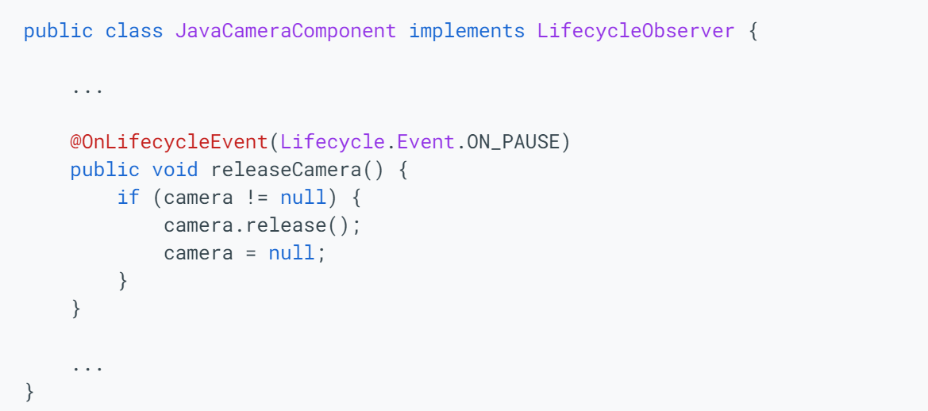

Slide 14
onStop()
When your activity is no longer visible to the user, it has entered the Stopped state, and the system invokes the onStop() callback. This may occur, for example, when a newly launched activity covers the entire screen. The system may also call onStop() when the activity has finished running, and is about to be terminated.

Slide 15
onDestroy()
onDestroy() is called before the activity is destroyed. The system invokes this callback either because:
the activity is finishing (due to the user completely dismissing the activity or due to finish() being called on the activity), or
the system is temporarily destroying the activity due to a configuration change (such as device rotation or multi-window mode)

